Slide 1

Malignant Comments Classifier
K. Rahul Ramanujam

Slide 2

Problem Statement: The proliferation of social media enables people to express their opinions widely online. However, at the same time, this has resulted in the emergence of conflict and hate, making online environments uninviting for users. Although researchers have found that hate is a problem across multiple platforms, there is a lack of models for online hate detection.
Online hate, described as abusive language, aggression, cyberbullying, hatefulness and many others has been identified as a major threat on online social media platforms. Social media platforms are the most prominent grounds for such toxic behaviour.
There has been a remarkable increase in the cases of cyberbullying and trolls on various social media platforms. Many celebrities and influences are facing backlashes from people and have to come across hateful and offensive comments. This can take a toll on anyone and affect them mentally leading to depression, mental illness, self-hatred and suicidal thoughts.
Internet comments are bastions of hatred and vitriol. While online anonymity has provided a new outlet for aggression and hate speech, machine learning can be used to fight it. The problem we sought to solve was the tagging of internet comments that are aggressive towards other users. This means that insults to third parties such as celebrities will be tagged as unoffensive, but “u are an idiot” is clearly offensive.
Our goal is to build a prototype of online hate and abuse comment classifier which can used to classify hate and offensive comments so that it can be controlled and restricted from spreading hatred and cyberbullying.

Slide 3

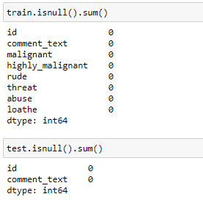
1) Data Cleaning: This phase of the project involves the data to undergo stages like getting rid of null values, outliers, extra info (symbols) and make it EDA ready.
From the above snips, it is clear that there are no missing values in both train and test dataset.

Slide 4
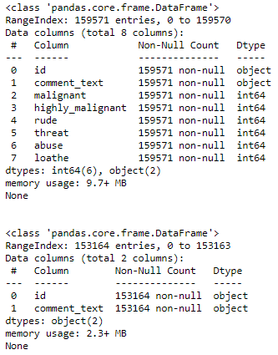
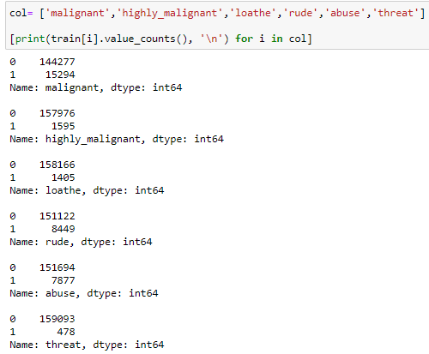
2) EDA: This stage involves how the data is explored and analysed to draw better inferences and understand the data better.
Above snips shows analysis of the data, the categorical values are binary in nature having 0 or 1. The above right pic shows the unique value count.

Slide 5
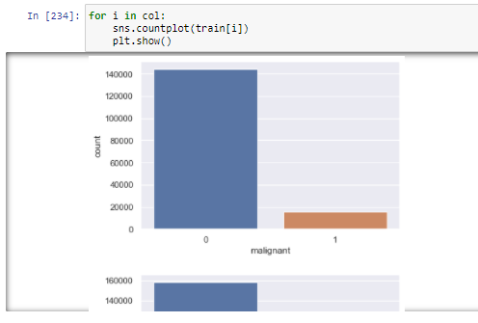
3) Visualization: The data is now ready with no missing values or other extra factors. We can plot the data to draw better inferences out of those and understand how the features are playing its role.
i) Countplot:
The unique value count of features are represented in countplot. It helps to understand the data distribution better.

Slide 6
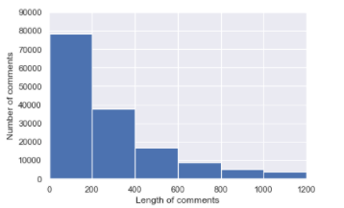
Analyse the no. of comments having lengths varying from 0 to 1200:
The plot shows length of comments in counter proportional with the no.of comments.
The length of comments reaching nearly 1200 words, it becomes tougher for the model to process and build. Thus, the plot representation helps to omit those comments which are more than 400 words.

Slide 7
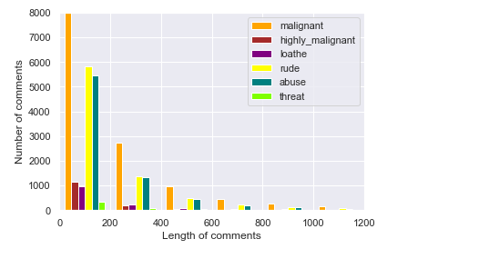
Features classification depending on their lengths:
The plot has the countplot in varied color showing each feature and its count in the data. With the help of this plot, it becomes easy to understand which features are more dominant.
The plots include: Length of comments, No.of comments.
The count of 'malignant' is high in every length of respective comment followed 'rude' and 'abuse'.
Malignant and rude, abuse seems to be in correlation with each other.

Slide 8
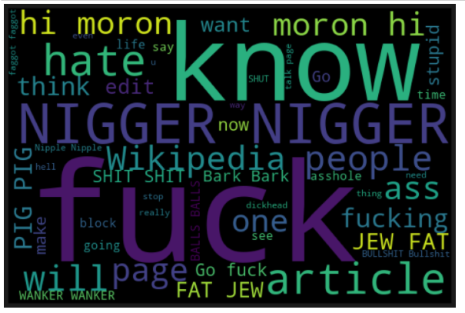
WordCloud: The representation of the most used words in the data can be shown in a single picture. Bigger the words are, bigger are their usage in the data.

Slide 9
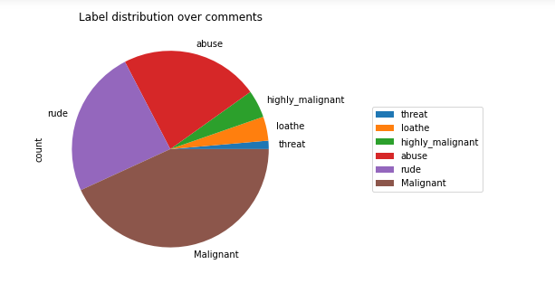
Pie Diagram: The wheel or sphere shows the distribution clearly to understand how much the data is spread features wise.
Malignant, rude and abuse labels are seen to be more.
The correlation among the above three features is high, it was clear in heatmap of correlaton as well.

Slide 10
4) Data Pre-Processing: The data is just one step away from the model building stage. We make the data ready in this phase by splitting it and giving the necessary changes to it.
1) Removing Punctuations and other special characters
2) Splitting the comments into individual words
3) Removing Stop Words
4) Lemmatising
5) Applying TfIdf Vectoriser
6) Splitting dataset into Training and Testing
All the above mentioned NLP methods were performed on the data to make it model ready.
7) SMOTE application on target variable.

Slide 11
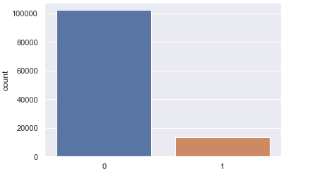

Synthetic Minority Oversampling Technique – SMOTE:
SMOTE is an oversampling technique where the synthetic samples are generated for the minority class. This algorithm helps to overcome the overfitting problem posed by random oversampling.
Target variable Y had ununiform distribution.
Thus, SMOTE helps in balancing the data.
Following is the snip which shows the balanced data.

Slide 12
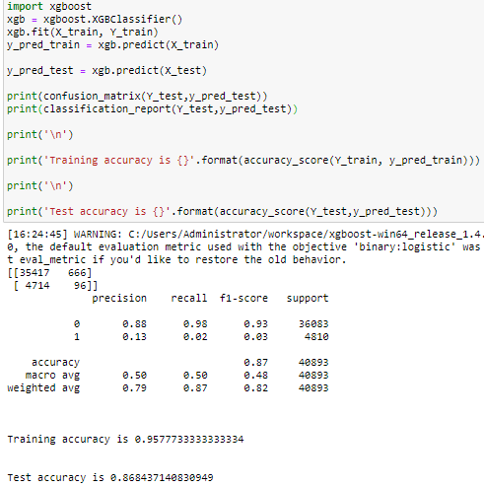
5) Model Building: Whatever that we’ve done till now to the data is for this stage, we build the models by using the data, train it, parameters are used, finally prediction is done. The model which gives the best accuracy score is retained and saved.
XGBRegressor:
The model is given with necessary inputs such as train and test datasets.
The XBBoost ensemble has always been a dependable to the data scientists for yielding the best possible results.
The r2 square we got is 0.87

Slide 13
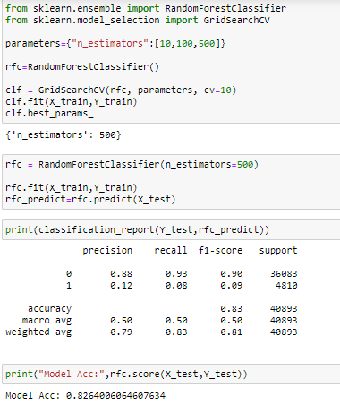
2) Random Forest Regressor:
The GridSearchCV is a reliable method to
Estimate the best possible parameters.
The best n_estimator is 500
And
accuracy achieved is 0.83
83% of the prediction is correct.
RFR model has always been reliable
Since they are second best after
XGBoost in yielding better results.

Slide 14
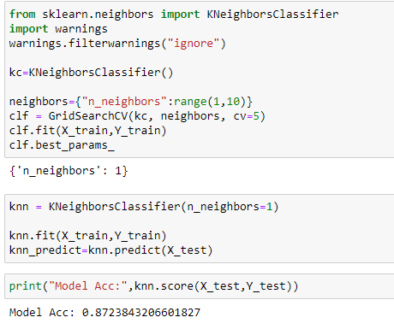
KNN:
Using GridSearchCV, the best possible parameters are used to get the accuracy of 0.87

Slide 15
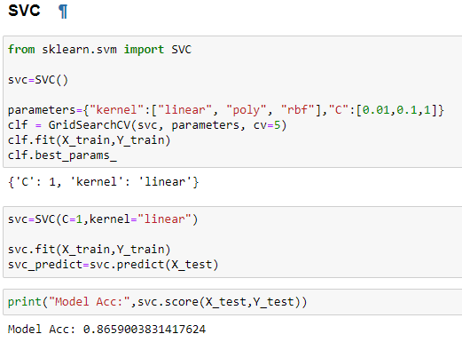
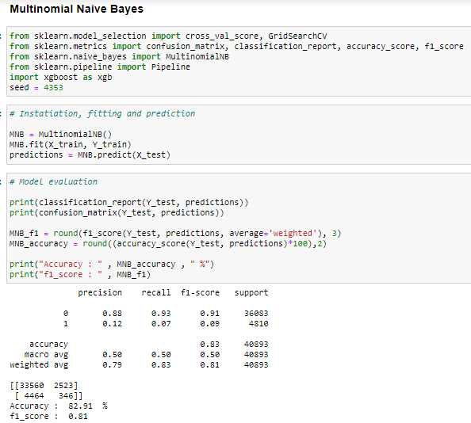
SVC: The hyperparamer tuning with the help of GridSearchCV has given the accuracy of 0.86
Naïve Baiyes: The best possible F1 score was 0.81 and accuracy score is 0.83

Slide 16
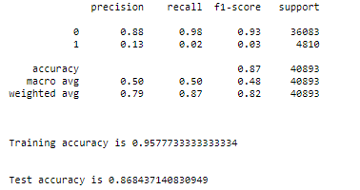
Out of all the models that were tested, XGBoost has the best accuracy score of 0.87.
Conclusion: The abuse that’s been prevalent on social media has been the prime cause for the depression and suicides. This model is built in order to tackle that problem by detecting the abuse off all comments and alarm the department to take action accordingly.
**The model is ready for the client to use and predict the rating out of their old review texts.** The final model is saved in a csv file named ‘test.csv’.
Thank you

